Slide 1
Chapter 9 Viralizing Video Clips
How do I viralize a YouTube video?

Slide 2
Introduction
YouTube dominates the market of user-generated video content
Viralization
what exactly does it take for a video to become viral
YouTube viewing is an example of [information spread creates dependencies]

Slide 3
YouTube was founded in February 2005 by three former PayPal employees
In November 2006, it was acquired by Google
People watch videos on YouTube so much that the site became a search engine second in size only to Google itself
Addictive nature of recommendation sidebar brings viewers through a continuous stream of relevant short-clips for up to hours at a time before they click out of it
Average daily video view count
400 hours worth of new content was being uploaded every single minute, which is almost 66 years of content per day

Slide 4
Viral Style
What makes videos go viral?
YouTube logs user behavior, including interactions with their video player
This data is analyzed to see how people watch videos and which videos have gone viral
YouTube Insight – analytic tools
1st video achieving viral status?
Gangnam Style by PSY released in July 2012: 1st video ever to break 1 billion views in 5 months; it proceeds to hit 2 billion mark by May 2014

Slide 5
Viral Style (as of 2016)
Since 2013, 12 other videos have also broken 1 billion barrier
Second to Gangnam Style in view count as of early 2016 was Taylor Swift’s “Blank Space” with 1.3 billion views
Gangnam Style was still the only video to have hit two billion
When it surpassed 2,147,483,647 views in December 2014, YouTube appeared to have literally lost count, as the value displayed on the main page came to a grinding halt
Why?
32-bit counter: 2³¹-1

Slide 6
Bring Viewers to Videos
How does a video get so popular?
4 main paths may lead a viewer to a particular YouTube clip in the first place
a search with terms the video is tagged with, on sites like Google
a referral from e.g., email, Facebook, or ads promoting the video
a subscription to YouTube channel that posts the video
a recommendation to the video given in YouTube’s sidebar
Subscription and recommendation play a bigger role in deciding a video’s popularity than # of likes/dislikes it has
How does YouTube generate its recommendations?

Slide 7
Bring Viewers to Videos
Does YouTube use a collaborative filtering algorithm like Netflix does for recommending movies?
Does it use PageRank-style algorithm like Google to rank clips by “importance?”
Neither algorithm translate well to YouTube
Why?
Unlike Netflix movies, YouTube videos are typically short in length and lifecycle, and have variable viewing behavior
make it hard to establish consistent system for users rating clips
For PageRank approach, need to “link” clips together somehow, e.g., by searching a video’s description for hyperlinks to other clips or by comparing tags between videos for matches in keywords
tags and descriptions can be rather unreliable in quality
YouTube video recommendation is different, and much simpler

Slide 8
Bring Viewers to Videos
We learned in Chapter 8 about co-participation - weighted links between students by their co-participation in discussion threads, and vice versa
YouTube keeps track of co-visitation count for pairs of videos, i.e., the number of times both videos were watched by a viewer in some recent time window, say past 24 hours
Weighted video-to-video graph
YouTube seems to take co-visitation graph and combines it with match of keywords in the video title, tags, and summary to generate recommendations
Often only those videos with watch-count similar to, or slightly higher than (why?), that of current video are shown in recommendation
positive feedback
(making widely watched videos to become even more widely watched)

Slide 9
Defining Viral
What is exactly is meant by “viral?”
total views over time looks like curve (c)
Three important features
high total view count
rapid increase of sufficient (long) duration
(sometimes) short time before rapid increase begins
No “golden formula” to guarantee a video will become viral

Slide 10
Popularity
Models that have been developed for information spread can give insight into why viralization may occur
Subjects of information spread
models have analyzed spread of “items” – ranging from physical products to diseases – through populations
Factors that attract people to an item in the first place???
intrinsic value that the item brings to a person - some may like it, regardless of what others think about it
in many instances, a person’s decision to obtain an item will depend on others
network effect

Slide 11
Network Effect
Network effect for two reasons
value of service or product may depend on the number of people who use it
examples of phone and FaceBook
positive network effect - as more people use them, they become more valuable to each individual
knowing what others think about an item can affect your decision
have you ever watched a movie because your friends told you that it was good, irrespective of whether it is the genre you typically like?
peoples’ opinions and decisions are influenced by others
the crowds are no longer “wise”, because assumption of independence no longer holds. What results instead is fallacy of crowds

Slide 12
Popularity
Both intrinsic value and network effect apply to a person’s choosing to watch a video on YouTube
YouTube site itself does have a positive network effect
Which one is more influential?
intrinsic value of the clip to the person (whether it matches her preferences)
fallacy of crowds (whether she sees/knows a lot of other people watching it)
network effect that spread video viewing through population, and hence has a larger impact on a video going viral
Need to quantify network effect

Slide 13
Fallacy of Crowds
Quantifying network effects is no easy task
dependent on individual, item, and situation of interest
Model for information cascade
Example of information cascade
What would you do if you saw someone standing on a street corner looking up at sky?
Thinking the person has nose bleed, and go on with your business
What if you saw ten people standing together looking up at the sky?
Probably stop and look, thinking that something may be wrong
This makes the crowd even bigger, so the next person passing by will see 11 people, which is even more convincing to stop and look

Slide 14
Information Cascade
People follow actions of the crowd, and ignore their own internal reasoning
Information cascade arises when [independence assumption about opinions (which is behind the wisdom of crowds) breaks down]
Instead of complete independence in decision-making, decisions become completely dependent on what has happened before
e.g.: stock market bubbles, fashions, Volvo’s epic split, etc.
Positive feedback in sequential decision making

Slide 15
Information Cascade
You are more likely to stumble upon a video that is already popular
Even if the video doesn’t match your taste, you may be compelled to see what it’s all about
You might decide to stop viewing it if you don’t like it, but this will still count towards the viewing number shown next to the video, and partially determines its place on the recommendation page
A higher view count will in turn influence more people, and this accumulation keeps on building

Slide 16
Making Decision in Sequence
What process will eventually trigger an information cascade?
Sequential decision making - each person gets a private signal (e.g., my nose starts bleeding) and releases a public action (e.g., tilt my head to the sky)
Subsequent users can observe public action, but not private signal
When there are enough public actions of the same type (e.g., ten people looking at the sky), then all later users will ignore their own private signals and simply follow what others are doing
At this point, a cascade has been triggered……….
Key question of ?
how many public actions are enough?

Slide 17
Making Decision in Sequence
How many public actions are enough to trigger a cascade depends on situation
probably much harder to get everyone to watch your YouTube video than it is to get people to look up at the sky
A cascade can accumulate to a large size through positive feedback
more people display the same public action gives the next person more incentive to follow, which makes the group larger, thereby creating more incentive, etc.
positive feedback feeds off its own unabated influence, generating more influence, and continues to grows larger

Slide 18
Making Decision in Sequence
vs. negative feedback, which systematically counteract an effect to reach an equilibrium in network (through, e.g., distributed power control or usage-based pricing)
Is public action “right” or “wrong?”
could be either
“everyone is looking up, but there is nothing of interest in the sky” is wrong → an example of fallacy of crowds
Cascade is fragile: even if a few private signals are leaked to the public (one person shouts “I am looking up the sky because I have a nosebleed), the cascade can quickly disappear or even reverse direction. Why?
Since people are following the crowd, they have little faith in what they are doing, even though many are doing the same thing

Slide 19
Number-guessing thought Experiment
A group of people lined up to play a game in which they will guess one number
The moderator has picked either 0 or 1 to be the (single) true number
One at a time, each person comes up to a blackboard, where she is to write down what she think (guess) the number is
The moderator has two cards, one of which has a 0 written on it, and one of which has a 1
When a person comes up, the moderator shows him/her a card, with either 0 or 1 written on it – serving as the person’s private signal
There’s no guarantee that the number a person is shown will be right, but everyone is told that there’s a higher chance that the card they are shown is right than wrong
80%
0
0
20%
1
80%
1
1
20%
0
If the true number is 0, the moderator has a chance, say 80%, of showing the 0 card, 20% of showing the 1 card
If the true number is 1, the moderator has a chance, say 80%, of showing the 1 card, 20% of showing the 0 card
Each person’s guess written on blackboard is her public action
When a person making a guess, she gets to see public actions of everyone who guessed before her, but she does not get to see private signals they were shown

Slide 20
Number-Guessing thought Experiment
Consider 1st person Alice; what should she do?
There’s nothing currently on blackboard, so all she has to write (public action) is the number on the card (private signal) shown to her [she knows this number is more likely to be right than wrong]
Consider 2nd person Bob; how is his situation different from Alice’s?
Not only does Bob see [both public action that Alice wrote (PUB I) and his own private signal (PRV II)], he also knows how Alice reasoned
Bob cannot see Alice’s private signal, but he knows it must be the same as PUB I, because Alice had no other information when she guessed. So Bob really knows two private signals, PRV I and PRV II
if they are both 0, then obviously Bob will write down 0
if they are both 1, then similarly, Bob will write down 1
when different, randomly choose 0 or 1

Slide 21
Number-Guessing thought Experiment
Now, here comes the first chance of an information cascade starting…….
When 3rd person Cara goes up to board, what does she know?
she is shown a private signal (PRV III) on a card
she sees public actions of first two users (PUB I and PUB II) on blackboard
Cara needs to compare PUB I and PUB II
If they are different, Cara knows Alice’s and Bob’s private signals must have been different, too; Bob must have seen a mismatch and guessed randomly. These two conflicting private signals cancel out, leaving Cara (3rd) in exactly the same shoes that Alice – the 1st person – was. Cara would then just guess based on her own private signal, PRV III
3rd person
→ the 4th person will be in the same shoes as Bob

Slide 22
Number-Guessing thought Experiment
If PUB I and PUB II are the same (OO or 11)
if Cara’s PRV III matches, then it’s a no-brainer: she knows two private signals (hers and Alice’s) saying her number, and another (Bob’s) which could have matched. So, Cara should pick this number for PUB III
EVEN IF Cara’s PRV III doesn’t match PUB I and PUB II, it turns out that her best guess is to ignore her private signal and go with the public action anyway
So, if “first two” people (e.g., Alice and Bob) write down the same guess, then an information cascade starts. The 3rd person’s (Cara’s) rational choice is just to keep with the crowd
If the 3rd person went with the crowd, then the 4th person will, and so on (until something else comes along to break up the cascade)

Slide 23
Number-Guessing thought Experiment
Why does a cascade start after “first two” people?
Cara knows what Alice’s [first person’s] private signal is
Given [PUB I = PUB II] ≠ PRV III → PRV I ≠ PRV III & cancel out
So Cara’s decision comes down to what she can guess about Bob’s private signal
Going back to Bob’s decision, there’s two ways in which his public action could have matched Alice’s
Bob’s PRV II matched Alice’s PUB I (i.e., Bob’s PUB II = Bob’s PRV II)
Bob’s PRV II didn’t match Alice’s PUB I, but when he chose randomly he landed on PUB I (i.e., Bob’s PUB II ≠ Bob’s PRV II)
Which case is more likely?
(1) is more likely. So, Cara knows it is more likely than not that Bob is guessing his private signal
Therefore, Cara’s best bet is to guess whatever PUB II is, and we have an information cascade started…....

Slide 24
Number-Guessing thought Experiment
What if no cascade has started after “the first” two people? Then everything restarts, and a cascade could just as well start after the next two people, and then the next two, and so on
All it takes is some even-numbered person to show the same public action as the odd-numbered person right before her

Slide 25
Starting a Cascade
How long, can we expect, it will take for a cascade to start?
How easy can it be to break a cascade? [Emperor’s New Clothes]
The first pair of guessers
Alice and Bob constitute the first pair of people to guess
Assume that moderator has decided on 1 as the correct number, and that the chance that she shows each person a 1 as their private signal is 80% (termed moderator’s chance)
Enumerate different types of cascades by a tree diagram
1
All six possible scenarios arising from private signals of first two guessers
IC

Slide 26
Starting a Cascade
1
Alice getting (and guessing) 1 [PUB I = 1]
Bob getting 0
reasoning that Alice got 1
Bob flipping a coin and guessing 1 [PUB II = 1]
Starting a correct cascade of 1

Slide 27
Starting a Cascade
1
When will there be no cascade at the end of their turns?
For this to happen, PUB I ≠ PUB II
What is the probability that no cascade will have been triggered at the end of their turns?
P(PUB I = 0 & PUB II = 1)
+ P(PUB I = 1 & PUB II = 0)

Slide 28
Starting a Cascade
The probability that moderator shows each person a 1 as his/her private signal is 80%
1
Probability of Alice getting (and guessing) 0
0.2
Probability of Bob getting 1
0.8
Probability of Bob flipping a coin and guessing 1
0.5
P(PUB I = 0 & PUB II = 1) = 0.2 * 0.8 * 0.5 = 0.08

Slide 29
Starting a Cascade
The probability that moderator shows each person a 1 as his/her private signal is 80%
1
Probability of Alice getting (and guessing) 1
0.8
Probability of Bob getting 0
0.2
Probability of Bob flipping a coin and guessing 0
0.5
P(PUB I = 1 & PUB II = 0) = 0.2 * 0.8 * 0.5 = 0.08

Slide 30
Starting a Cascade
1
Probability that no cascade will have been triggered at the end of Alice’s and Bob’s turns
= P(PUB I = 0 & PUB II = 1) + P(PUB I = 1 & PUB II = 2)
= 0.08 + 0.08 = 0.16

Slide 31
Starting a Cascade
Probability that a cascade will occur?
(1 – 0.16) = 0.84
Probability of a correct cascade [11] = 0.64 + 0.08 = 0.72
probability of both Alice and Bob getting 1 = 0.8 * 0.8 = 0.64
probability of Alice’s PRV I = 1 and Bob’s PRV II = 0 and flipping a coin to get 1 = 0.8 * 0.2 * 0.5 = 0.08
Probability of incorrect cascade [00] = 0.08 + 0.04 = 0.12

Slide 32
Starting a Cascade
72% (0.72) is pretty high. Why?
Assumption that moderator, with 80% chance, shows the correct private signal (1) to each person
If we lower it, both incorrect cascade and no cascade would become more likely

Slide 33
Future Pairs of Guessers
After Alice and Bob, the chance of no cascade is 16% (8% + 8%)
How about after Cara (3rd person), then?
The third person cannot by herself trigger a cascade; if none was triggered after Bob (and Alice), then Cara starts from scratch with no information, effectively in Alice’s shoes
So after the first three people, the probability of no cascade is still 0.16
How about after Dana (4th person)?

Slide 34
Future Pairs of Guessers
For the first 4 persons, we have two ways that a cascade could be triggered: first after Alice and Bob, and then after Cara and Dana
To have no cascade at the end (of Dana), we need the first pair and the second pair to not trigger one
Multiply the chance of each pair not causing one: 0.16 x 0.16 = 0.0256 (2.56%)
After Dana, then, there’s more than a 97% chance that we will be in a cascade

Slide 35
Future Pairs of Guessers
How about after Evan (5th person)?
As the first person in the third pair, Evan cannot cause a cascade, so the probability of stays the same is 2.56%
After Frank (6th person)?
We have had three chances of a cascade (after Bob, Dana, and Frank) so the probability of not having a cascade = (0.16)³ = 0.0041 = 0.41% [a very small chance of not having a cascade]

Slide 36
Future Pairs of Guessers
Probability of still having no cascade after ‘N’ pairs = (0.16)^{N}
This probability is going very quickly to zero
After a few pairs, we are more or less guaranteed that we will have a cascade. At this point, the decisions of future people have become entirely dependent on what is on the board already
What affects the type of cascade (correct or incorrect)?
moderator’s chance (probability) itself, irrespective of the number of pairs

Slide 37
Effects of Moderator’s Probability
When moderator’s probability is 50%, the same chance (~38%) of correct as incorrect cascade, and less of a chance of no cascade
As probability increases, chance of correct cascade increases, while that of incorrect and no cascade decrease
When it reaches 100%, the outcome is guaranteed to be correct cascade

Slide 38
The Emperor’s New Clothes
It is easy to start a cascade. Once triggered, how long will one last?
Forever, unless there is some kind of disturbance, e.g., a release of private signals
How many disturbances would it take to break a cascade?
A few will often suffice, no matter how long the cascade has been going on
Despite the number of people involved, everyone knows that they are just basically playing a game of following the leader to maximize their chance of guessing correctly
The Emperor’s New Clothes effect encapsulates the fragility of an information cascade

Slide 39
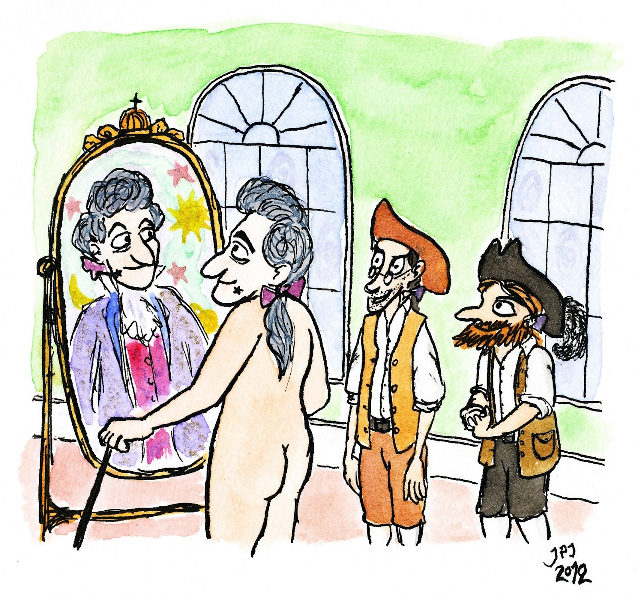
The Emperor’s New Clothes
19th century story by Hans Christian Anderson in which a vain emperor is told that his new “clothing” is of the finest fabric, invisible only to those who are unfit for their positions
In reality, there are no clothes at all. While everyone plays along (i.e., their public actions), not wanting to seem “unfit” (i.e., their private signals), it only takes one kid’s shouting “hey, he is wearing nothing at all!” before everyone becomes more confident that the emperor is truly disrobed in public

Slide 40
The Emperor’s New Clothes
In the context of number-guessing experiment. how do we break a cascade?
Suppose a cascade of 1’s has started after the first pair
Some time later, it’s Frank’s turn to guess, and he gets a 0 as his private signal. As his public action, he guesses 1, but he also shouts out that his private signal was 0
Now, Greg is up, and he also gets a private signal of 0. He has the following information about private signals
on the one hand, there’s at least one (private) 1, from Alice. But he cannot be sure if Bob had a (private) 1, because Bob could have gotten a 0 and flipped
on the other hand, there’s at least two 0’s: his and Frank’s
So, what will Greg guess?
0, because there’s more evidence of this being correct
This breaks the cascade…….

Slide 41
In the number-guessing experiment, it only takes two people to start a cascade
More generally, the size of the crowd needed to cause a person to ignore their instinct is dependent both on (i) scenario and (ii) individual
Also, the most overarching assumption made is that everyone acts rationally - everyone can, and will, decide what the best guess to make is depending on the information they have
but most people do not go through all of this probability thinking on the spot in their heads

Slide 42
From Cascade to YouTube
How can we translate sequential decision making to viralizing a YouTube video?
Not easy, but the main idea is clear
you want your video to undergo an information cascade, so that when a person sees or hears about it (i.e., the public action), they will most likely watch it, irrespective of whether or not it matches her intrinsic interest (i.e., her private signal)
How many public actions does it take before a person will watch your video automatically? Does such a number even exist? Even if it does, it will be different for everyone, depending on how malleable the person is
All interesting questions without clear answers

